Slide 1
Neural networks
Florin Gogianu
Bitdefender ML team
* using slides, illustrations and ideas from prof. Simon Prince UDLB, Stanford CS231n, LeCun, Canziani, NYU Deep Learning

Slide 2
Reading
Lecture 1: chapters 1, 2, 8.1-3, 9.1 from Prince, Understanding Deep Learning
Lecture 2:
chapters 3 and 4 from Prince, UDL book
LeCun, Bengio, Hinton, Deep Learning (paper)

Slide 3

hide & seek: emergent behaviour from sparse rewards

Slide 4
Recap
?

Slide 5
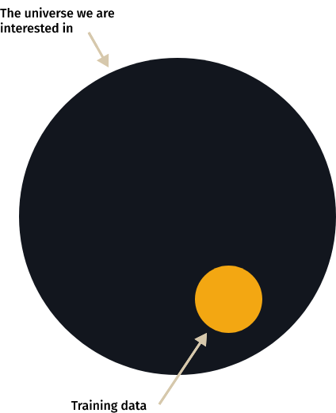
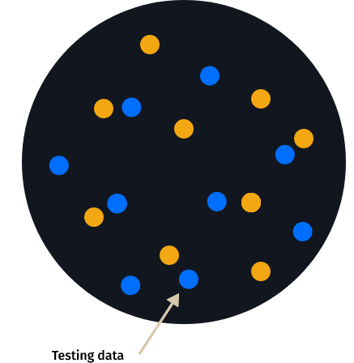
Another picture of train / test
What we want
What we get

Slide 6
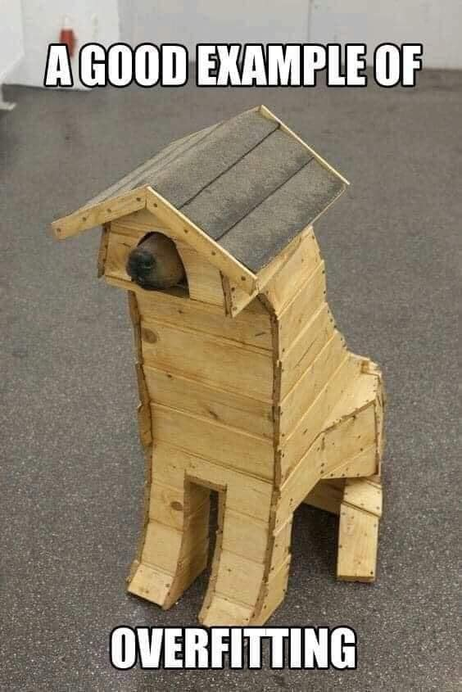

Slide 7
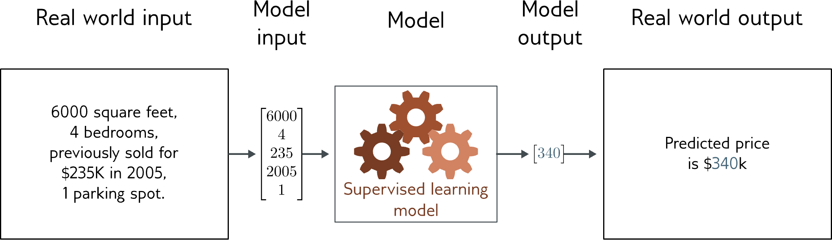
Linear regression
Univariate linear regression problem (one output, real value)

Slide 8
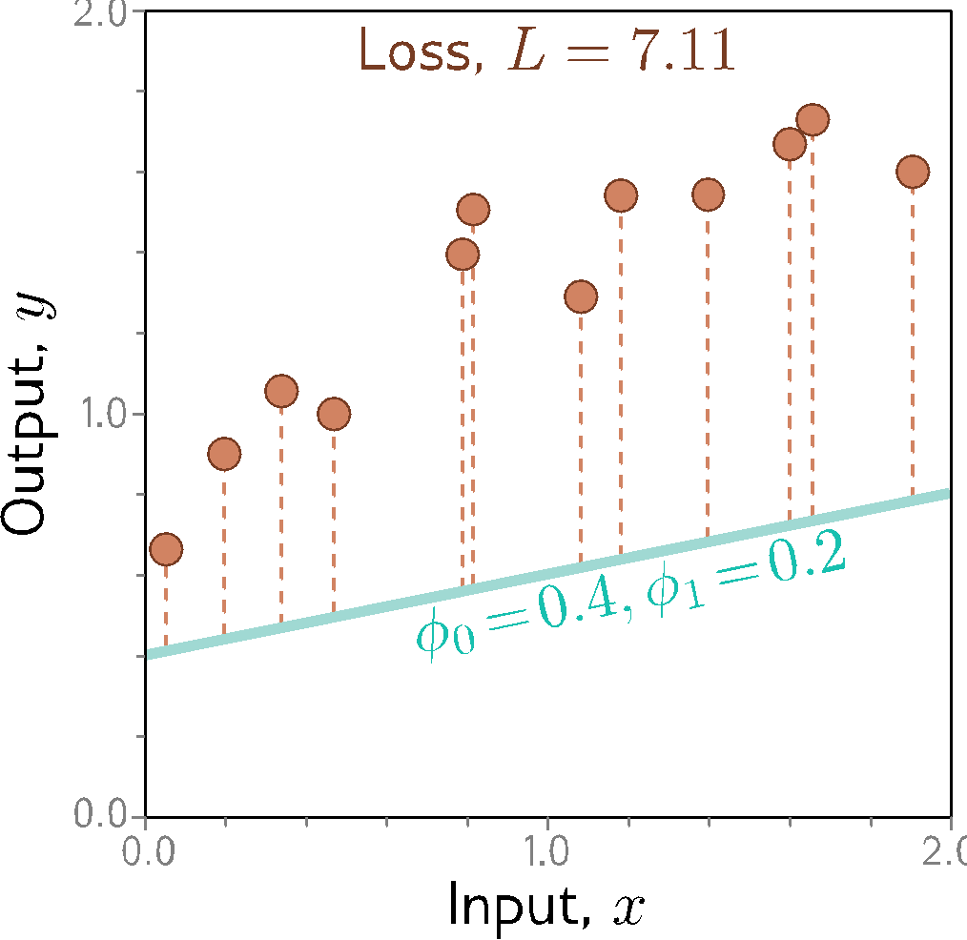
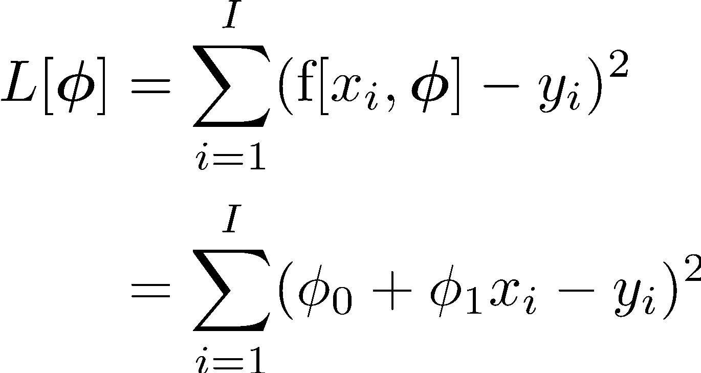
1D linear regression
Loss function:
?
?
Notes:
Cum se numește această funcție?
Care este rolul lui phi_0?

Slide 9
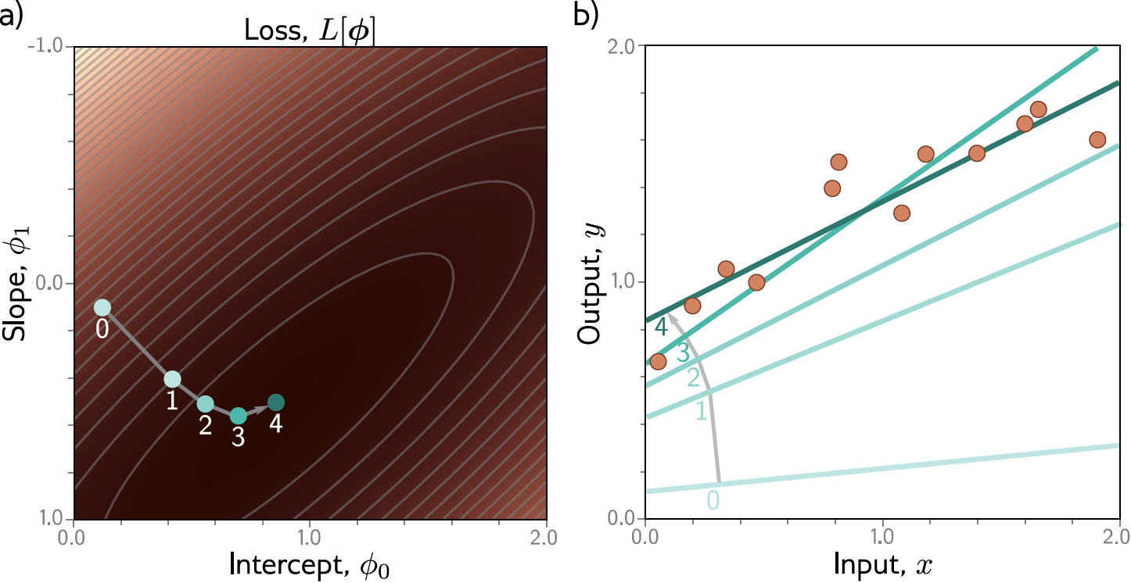
1D linear regression
Gradient descent

Slide 10
Shallow neural networks

Slide 11
Why neural networks
?
1D regression model is obviously limited:
Want to be able to describe input/output that are not lines
Want multiple inputs
Want multiple outputs
Neural networks
Flexible enough to describe arbitrarily complex input/output mappings
Can have as many inputs as we want
Can have as many outputs as we want

Slide 12
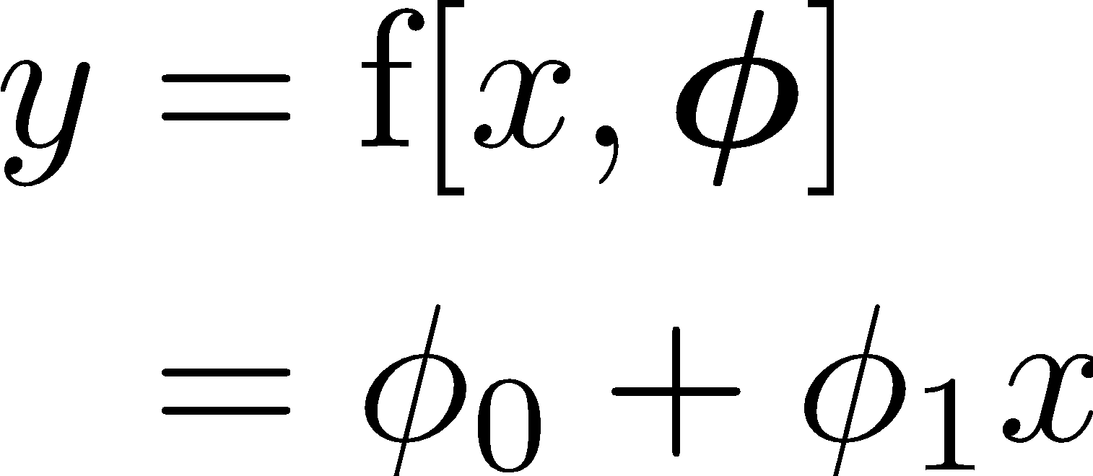
Consider a shallow neural network
Let’s go from a two-parameter linear model:
To something just a bit more complicated:

Slide 13
Shallow neural network

Slide 14
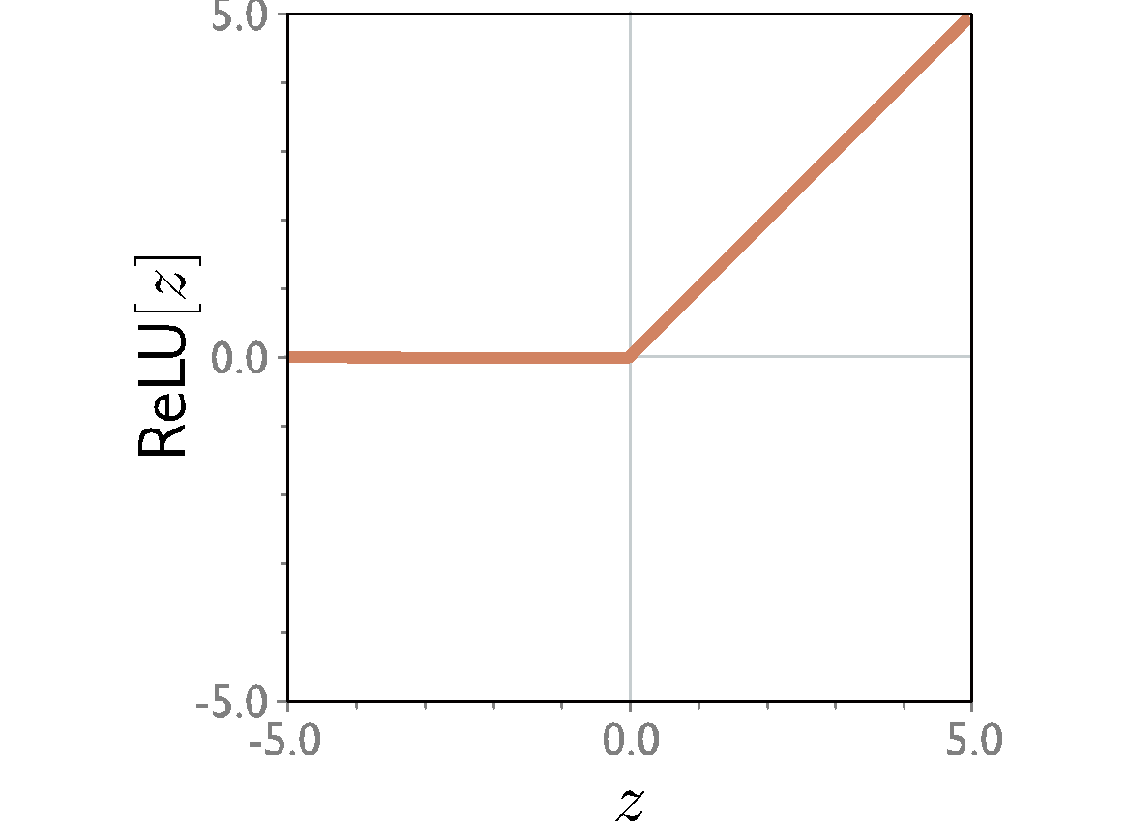
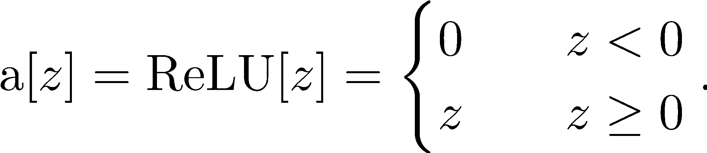
Shallow neural network
activation function
Rectified Linear Unit
(particular kind of activation function)

Slide 15
Shallow neural network
This model has 10 parameters:
Represents a family of functions
Parameters determine particular function
Given parameters can perform inference (run equation)
Given training dataset
Define loss function (eg.: least squares)
Change parameters to minimize loss function

Slide 16
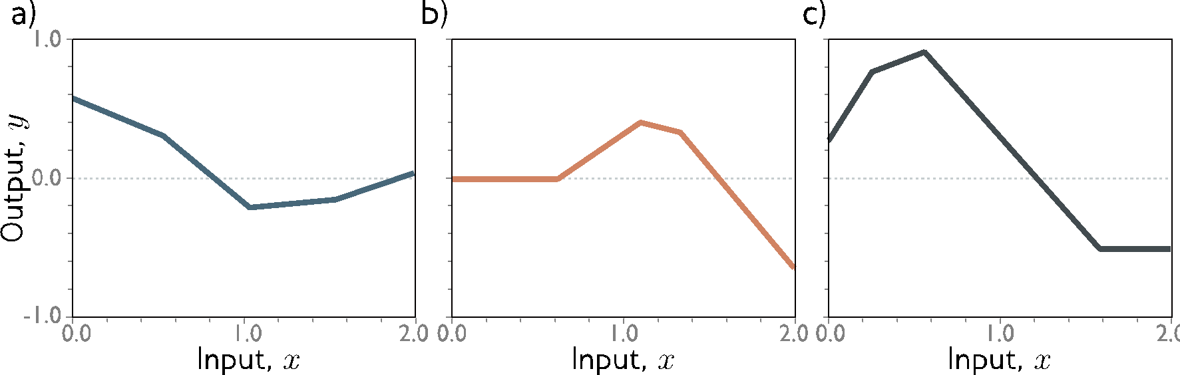
Shallow neural network
Piecewise linear functions with three joints

Slide 17
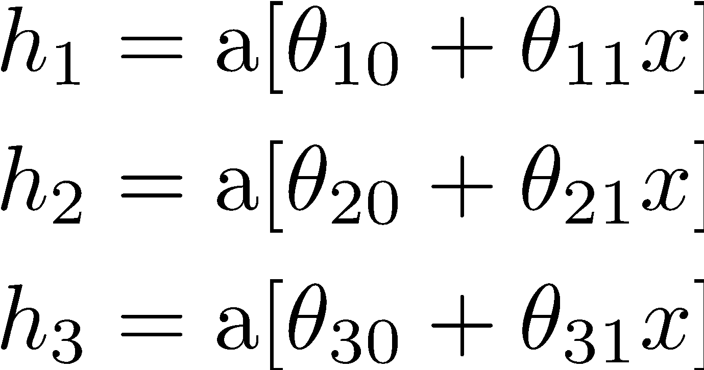
Shallow neural network
Break it down into two parts:
where:
hidden units

Slide 18
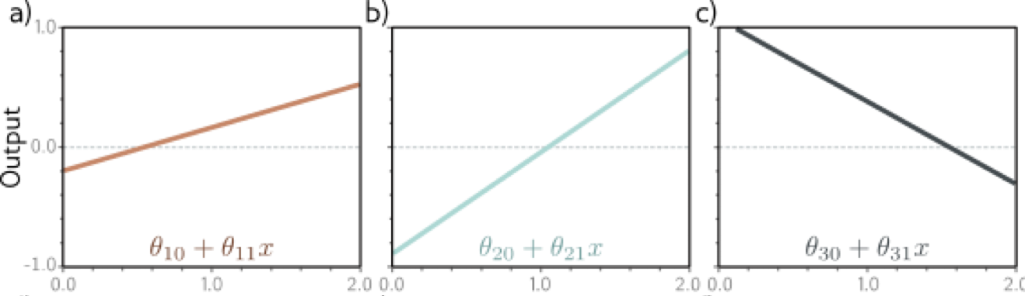
1. Compute three linear functions

Slide 19
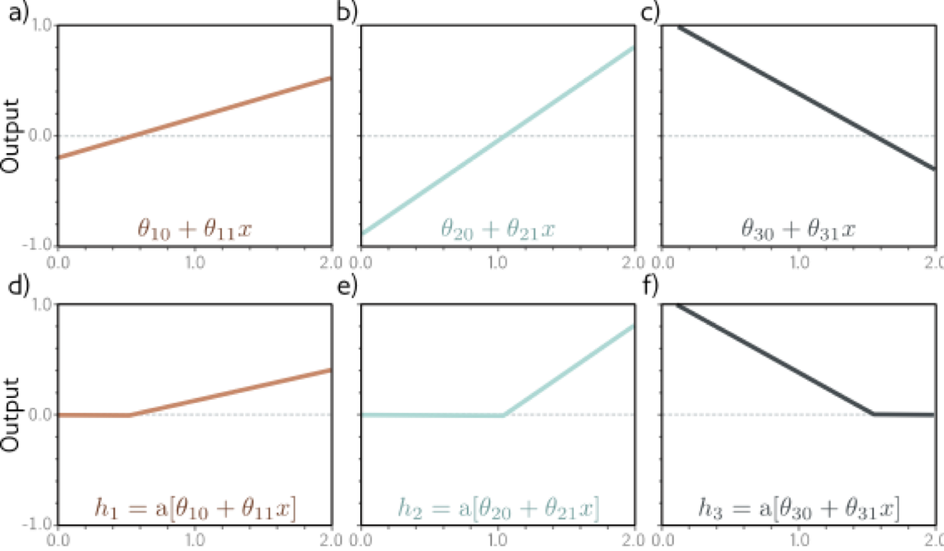
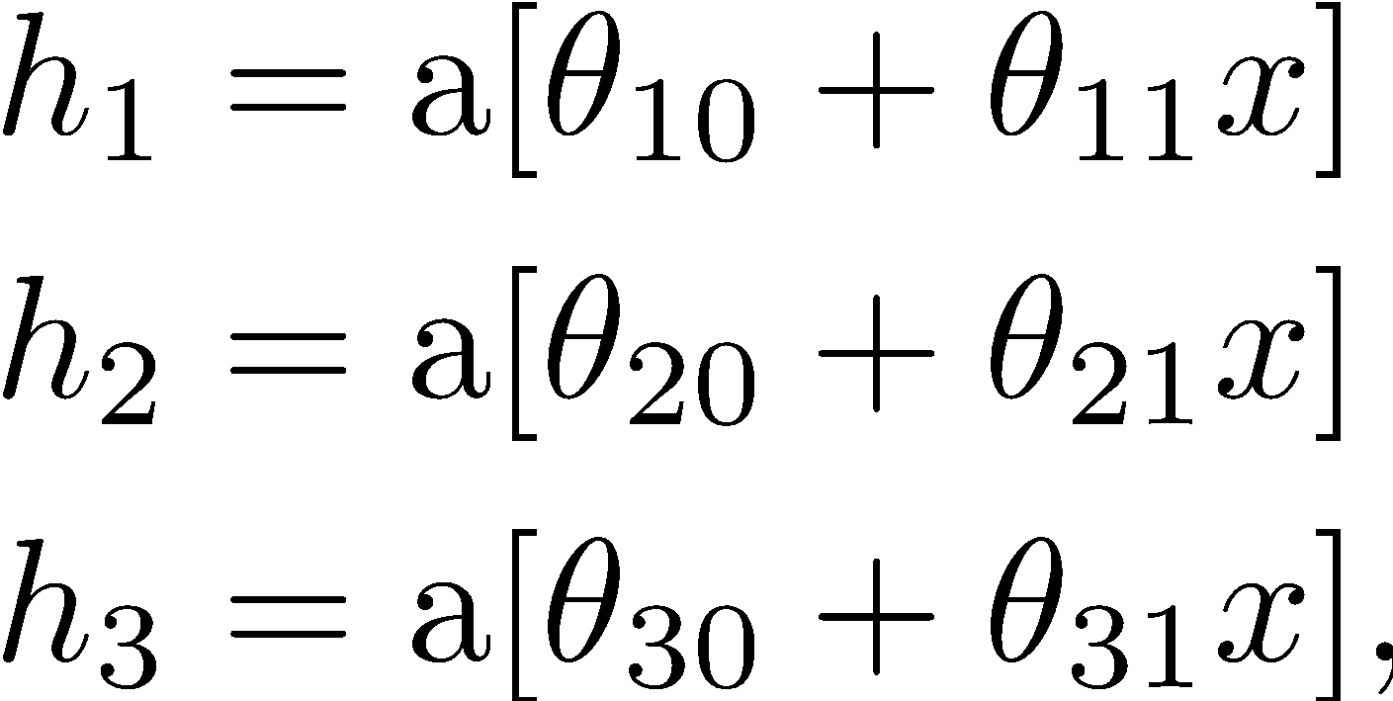
2. Pass through ReLU activations (hidden units)

Slide 20
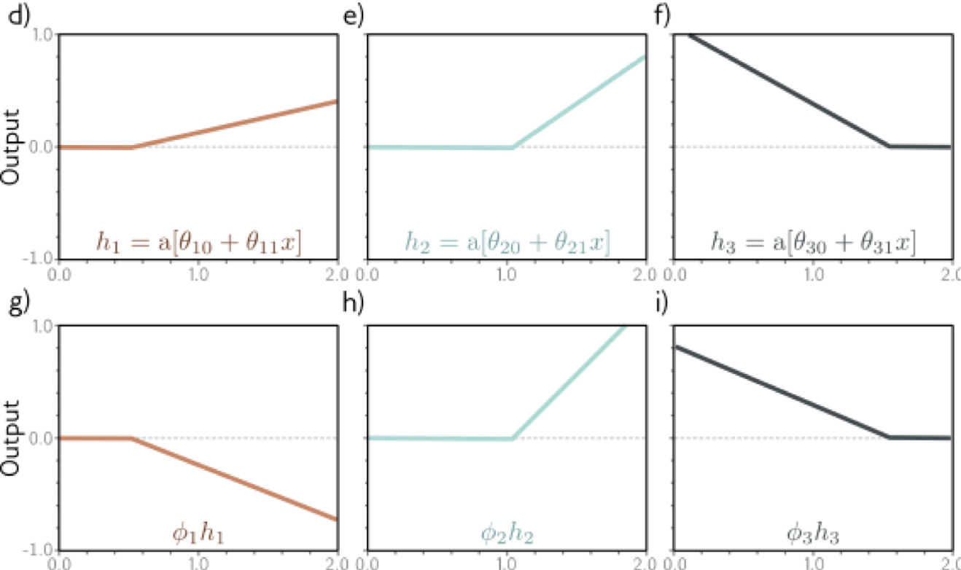
3. Weight the hidden units

Slide 21
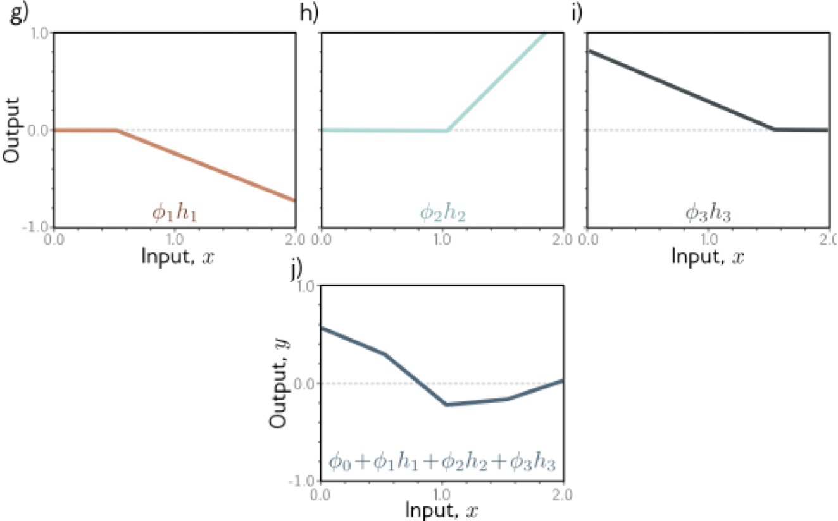
4. Sum the weighted activations

Slide 22
Shallow neural network
Piecewise linear functions

Slide 23
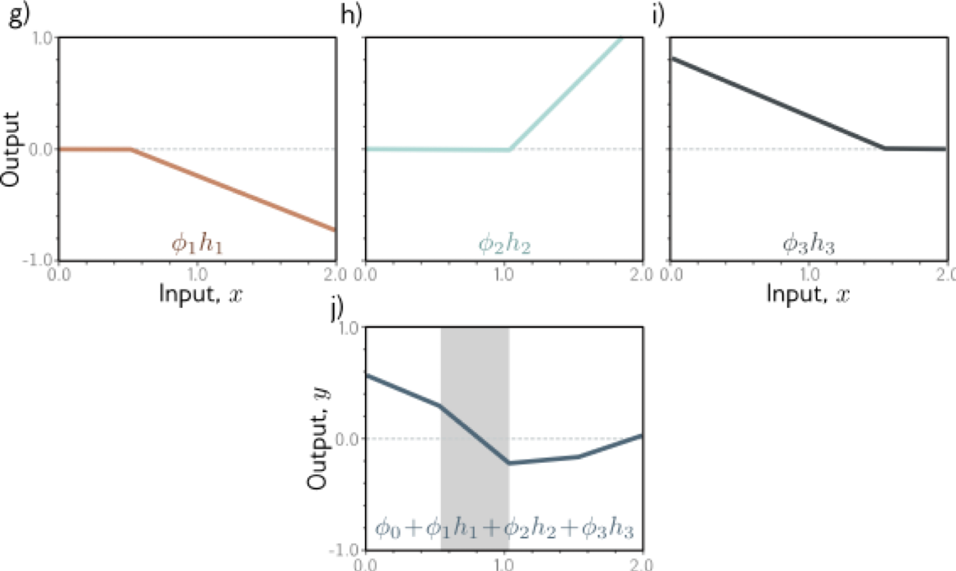
Activation pattern: which hidden units are activated
?
Shaded region: unit 1 active, unit 2 inactive, unit 3 active

Slide 24
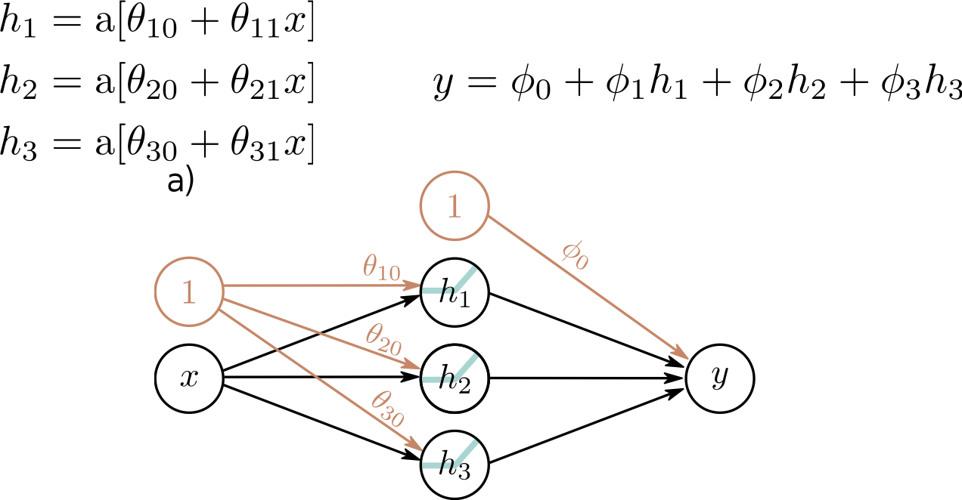
Depicting neural networks
Each parameter multiplies its sources and adds to its target

Slide 25
Universal approximation theorem

Slide 26
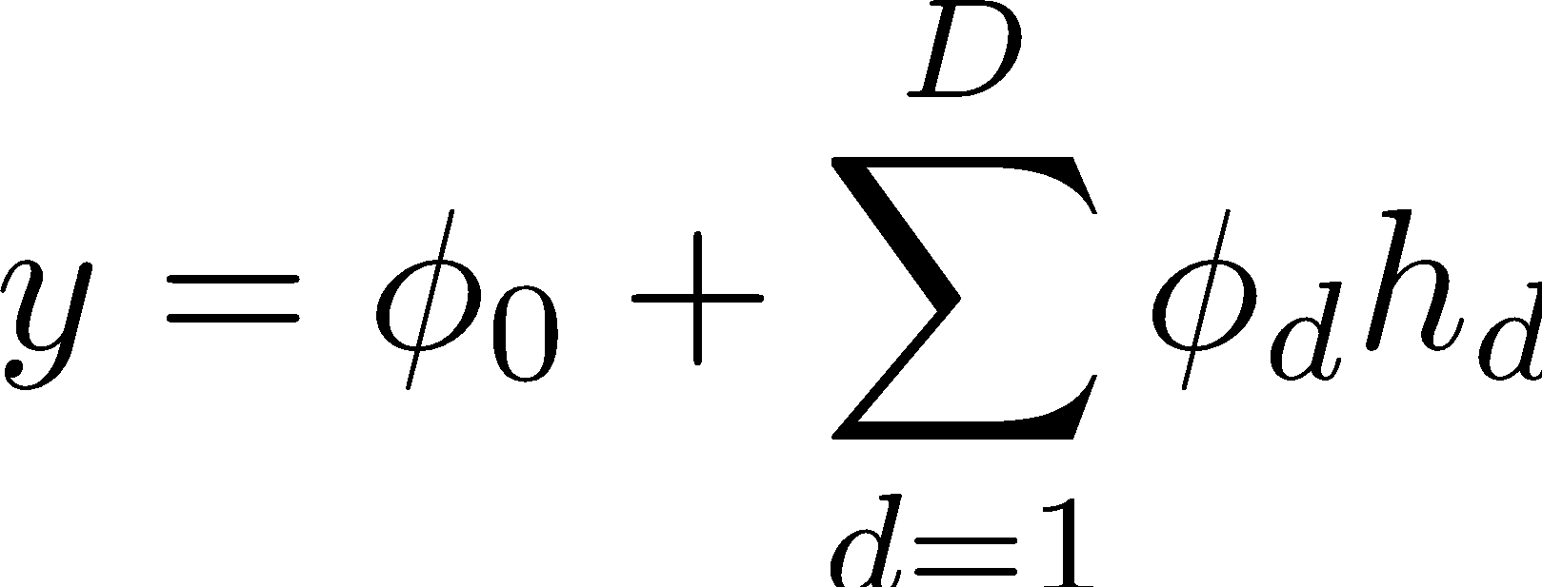
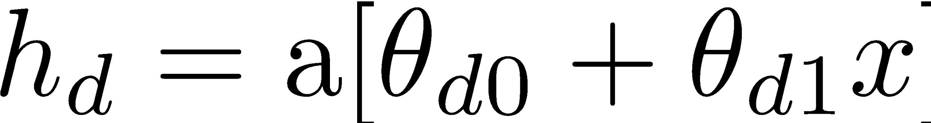
Arbitrary number of hidden units
From 3 hidden units:
To D hidden units:

Slide 27
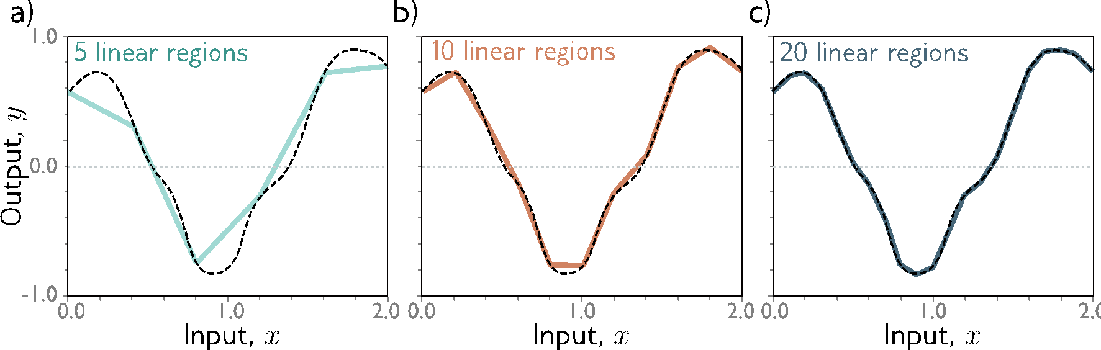
With enough hidden units…
… we can describe any 1D function to arbitrary accuracy!

Slide 28
Universal approximation theorem
“a formal proof that, with enough hidden units, a shallow neural network can describe any continuous function on a compact subset of ℝ^{D} to arbitrary precision”
Hornik, 1990
* without guaranteeing a construction though!

Slide 29
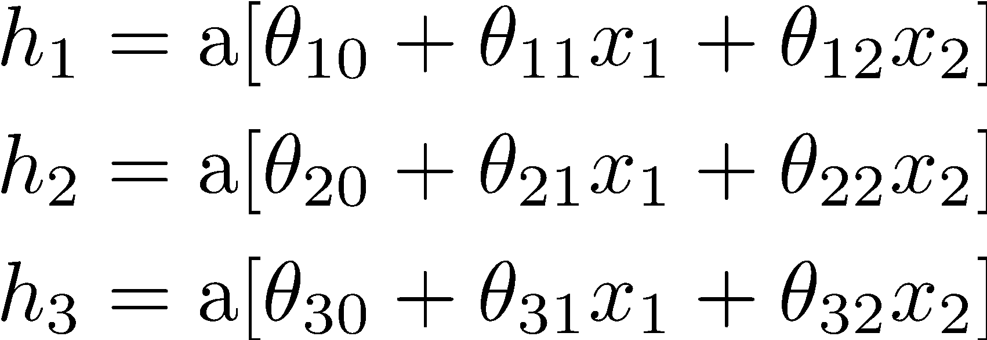
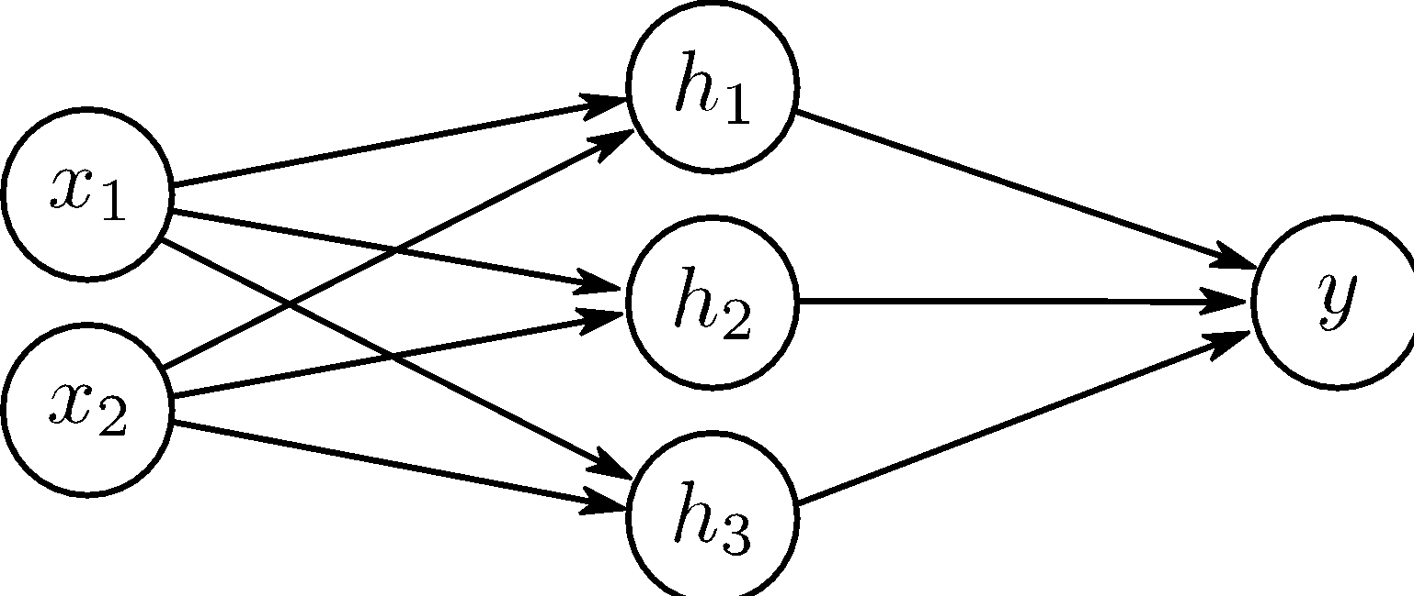
Multivariate inputs
2 inputs, 3 hidden units, 1 output

Slide 30
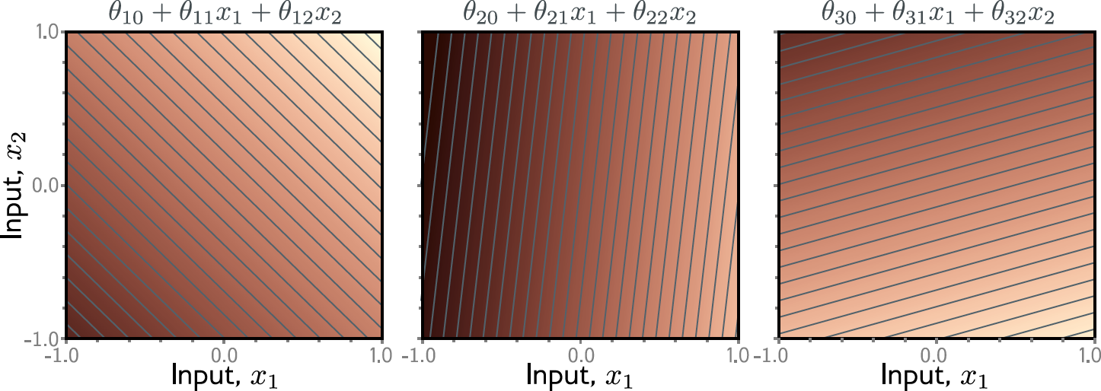

Slide 31
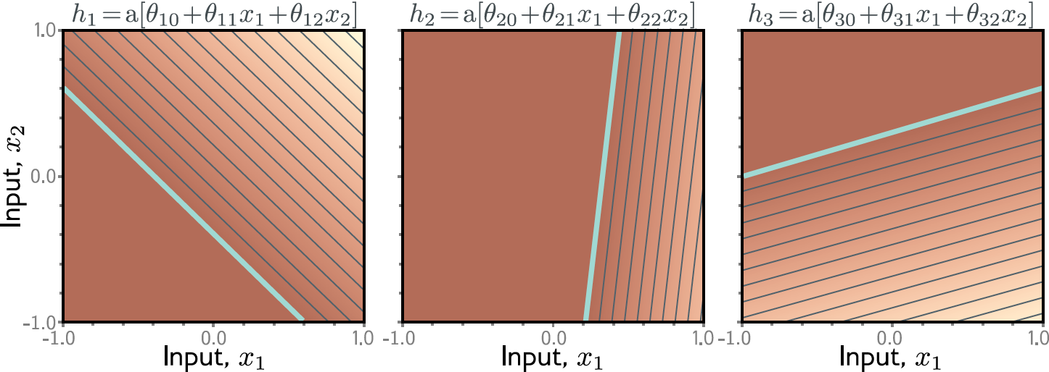

Slide 32
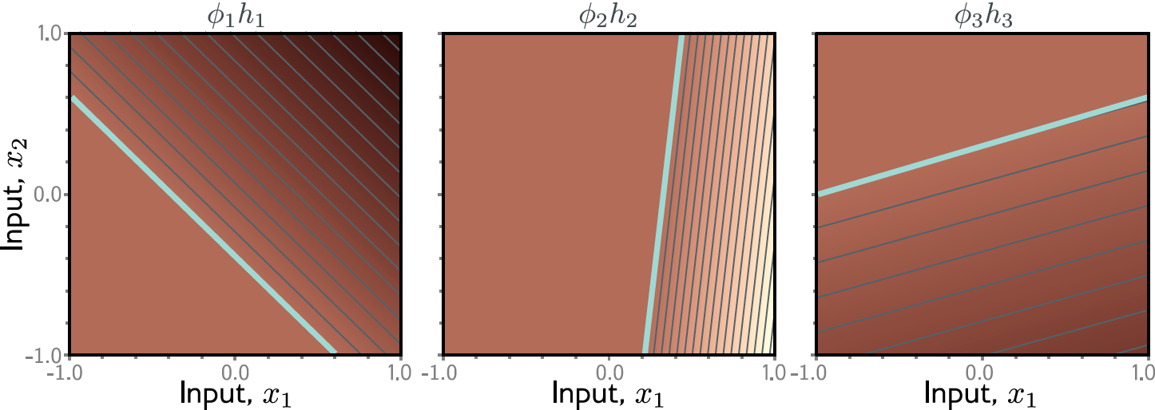

Slide 33
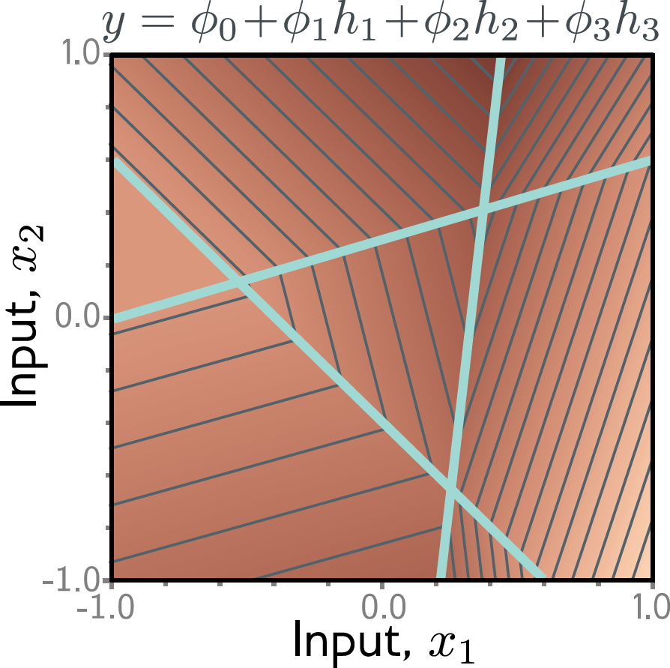

Slide 34
?
Convex polygons

Slide 35
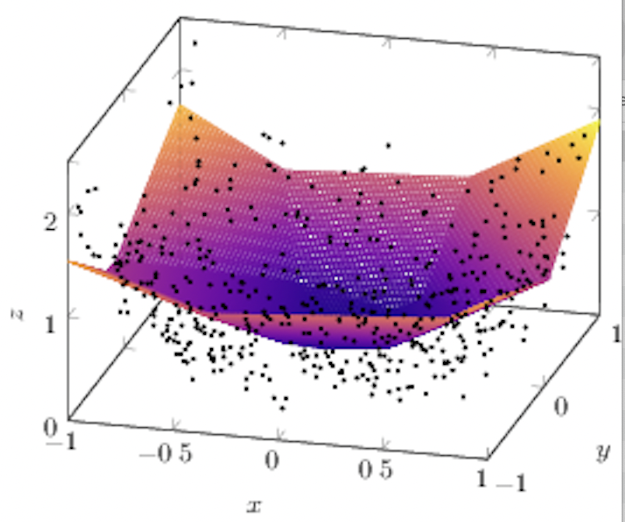
Fitting
Output, y
Input, x₂
Input, x₁

Slide 36
Question:
For the 2D case, what if there were two outputs?
If this is one of the outputs, what would the other one look like?

Slide 37
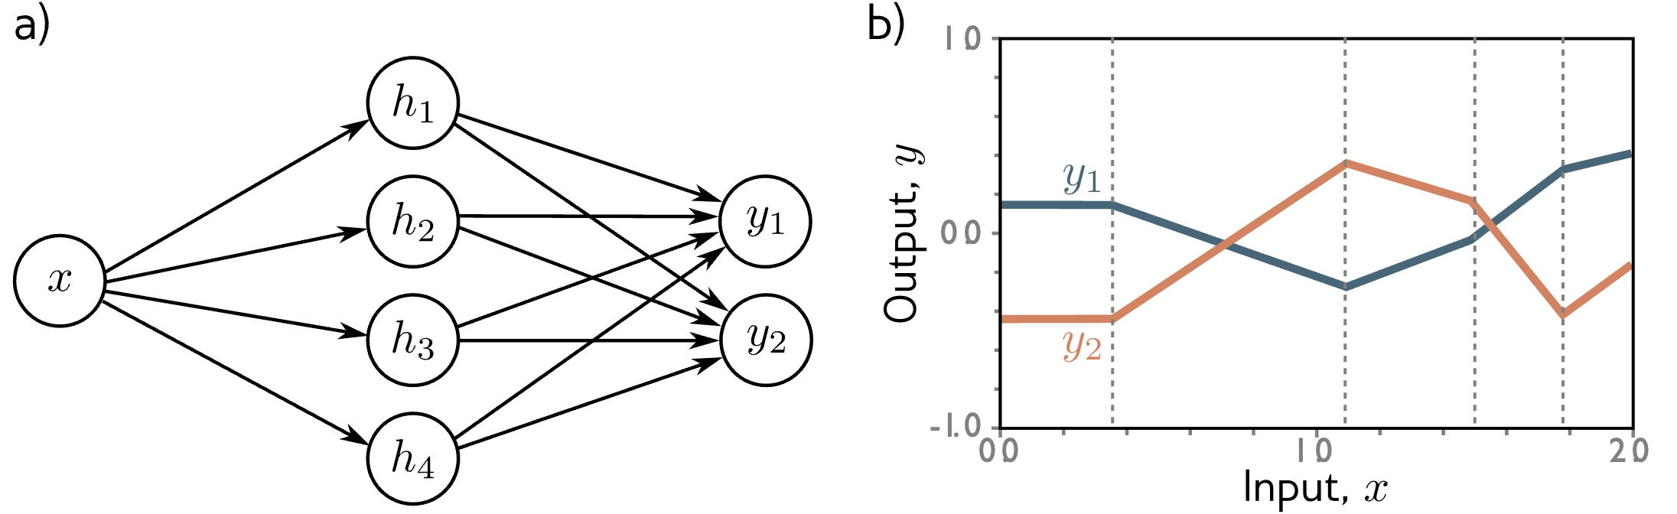
Multivariate outputs
?
1 input, 4 hidden units, 1 output

Slide 38
Functional vs. Representational

Slide 39
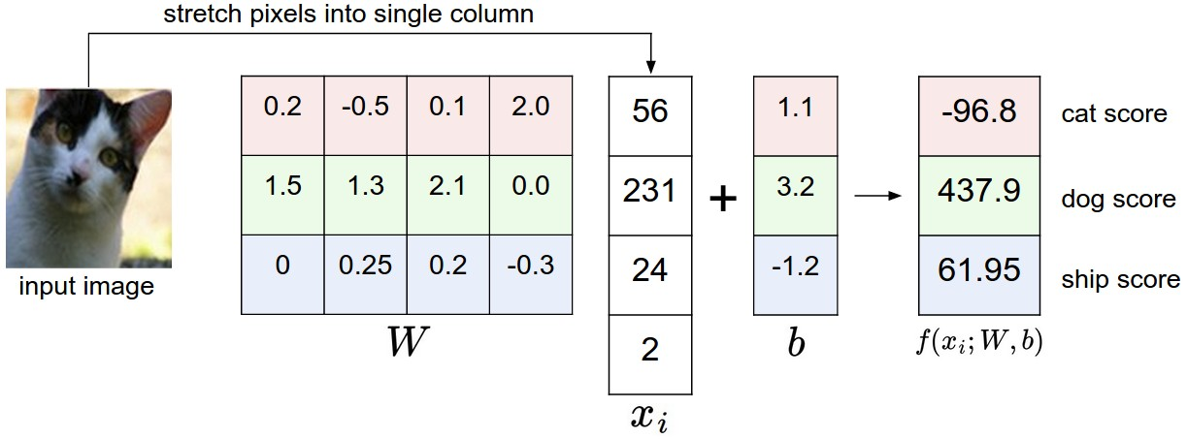
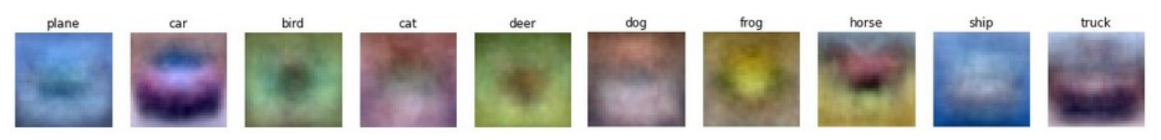
Linear classification

Slide 40
The representation view. Linear model
x₁
y₁
x₂
y₁
y = 𝚹x, that is y₁ = 𝜃₁₁x₁ + 𝜃₁₂x₂ , …
A linear model with four weights.
Also can be seen as two stacked ”neurons” without activation functions.

Slide 41
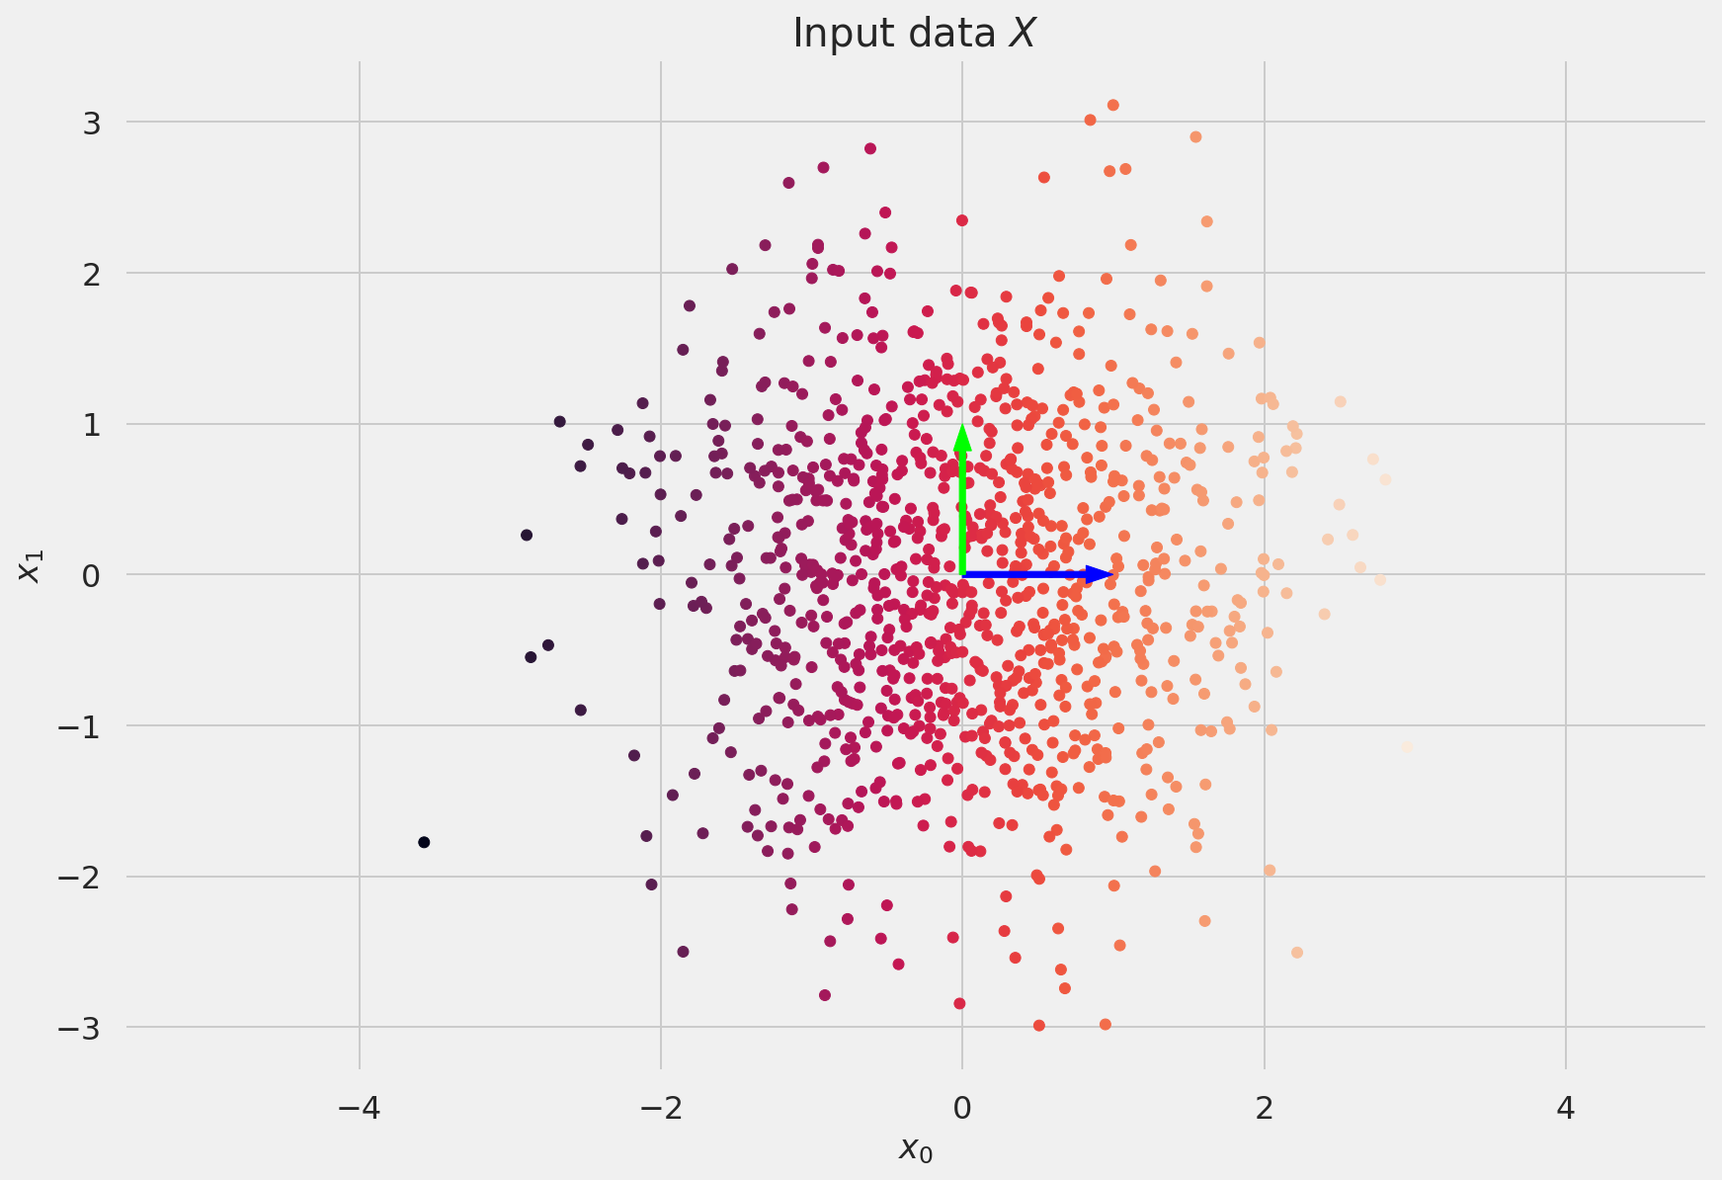
The representation view. Linear model

Slide 42
The representation view. Linear model
Our model is: y = 𝚹x
What is 𝚹 doing to x ?
Let’s perform singular value decomposition* for some intuition:
𝚹 = U S V^{T}
0.19 1.84
-0.97 -0.93
0.83 -0.55
-0.55 -0.83
2.17 0.00
0.00 0.74
0.32 0.94
0.94 -0.32
=
✕
✕
rotation
scale
reflection
* Deisenroth, Mathematics for Deep Learning, ch. 4.

Slide 43
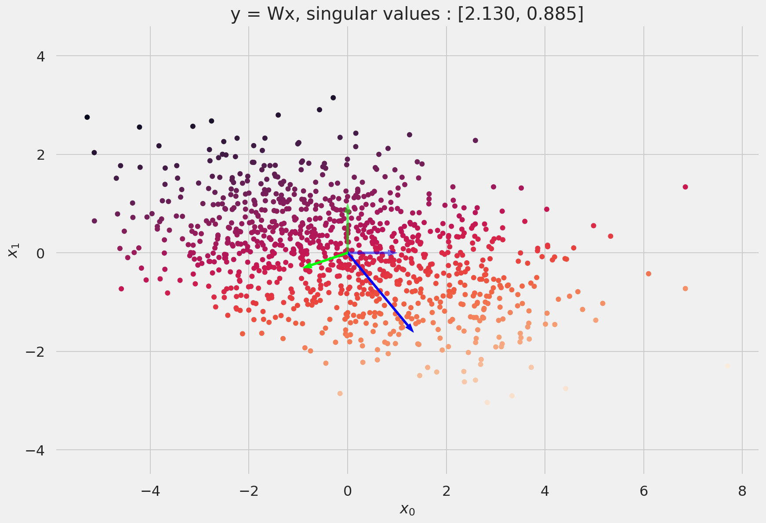
The representation view. Linear model

Slide 44
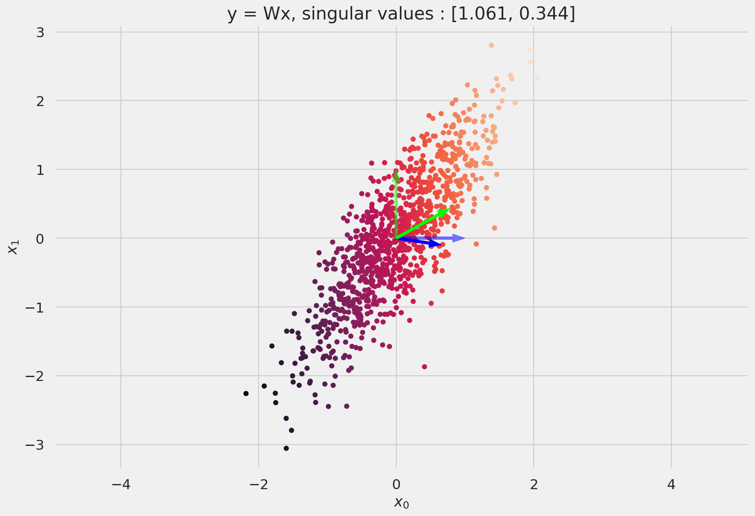
The representation view. Linear model

Slide 45
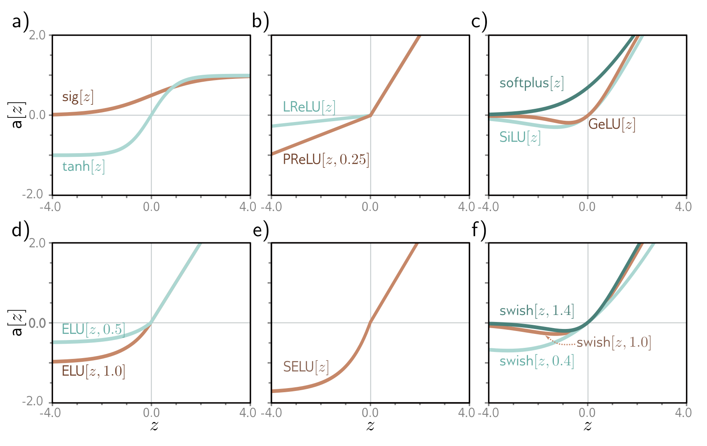
The representation view. Activation functions

Slide 46
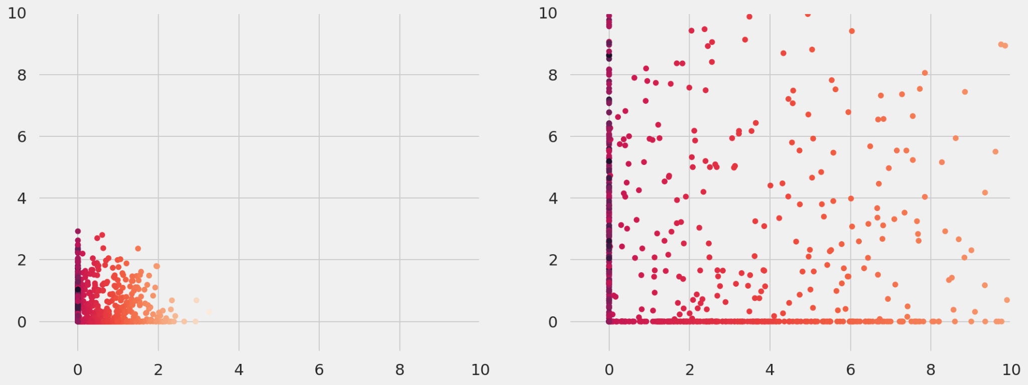
The representation view. Non-linear model | ReLU
ReLU(Sx) activation function with two different scale factors S

Slide 47
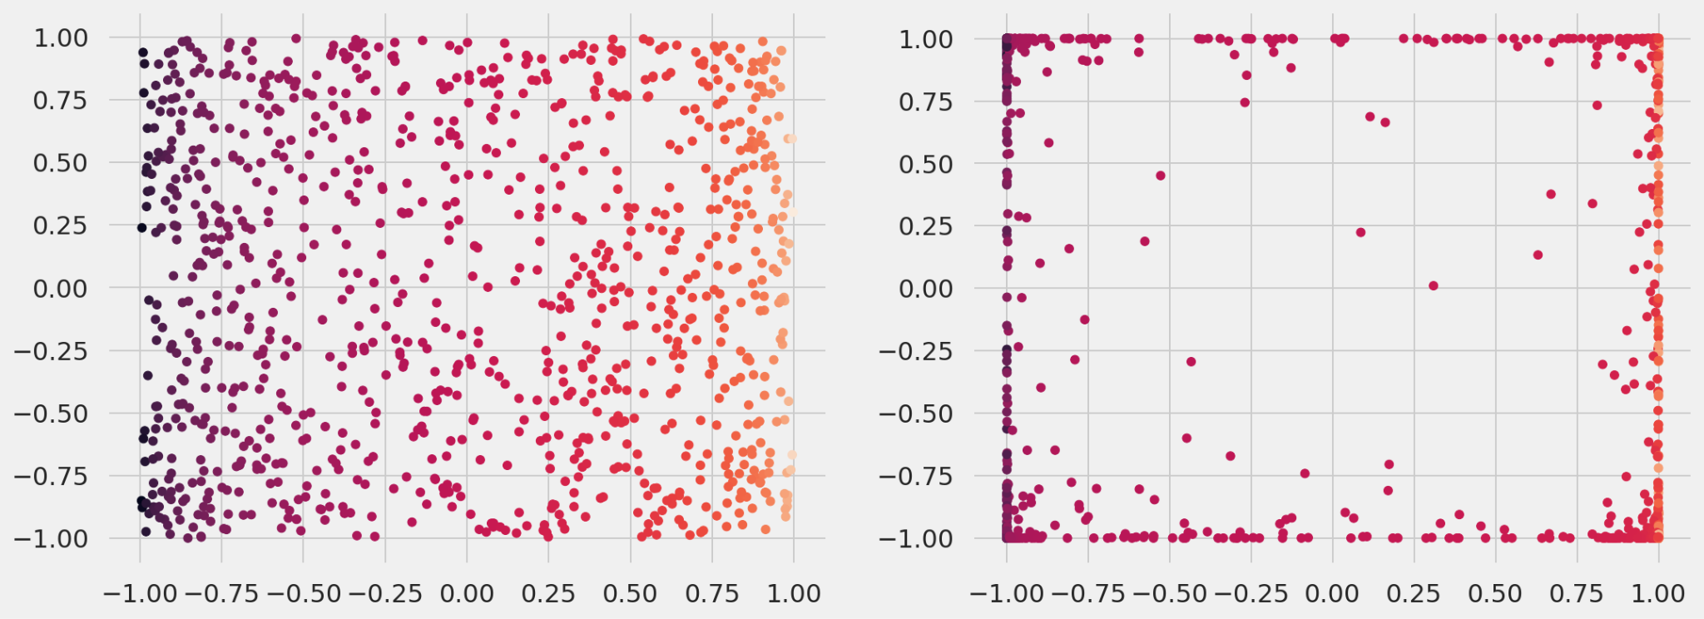
The representation view. Non-linear model | tanh
tanh(Sx) activation function with two different scale factors S

Slide 48
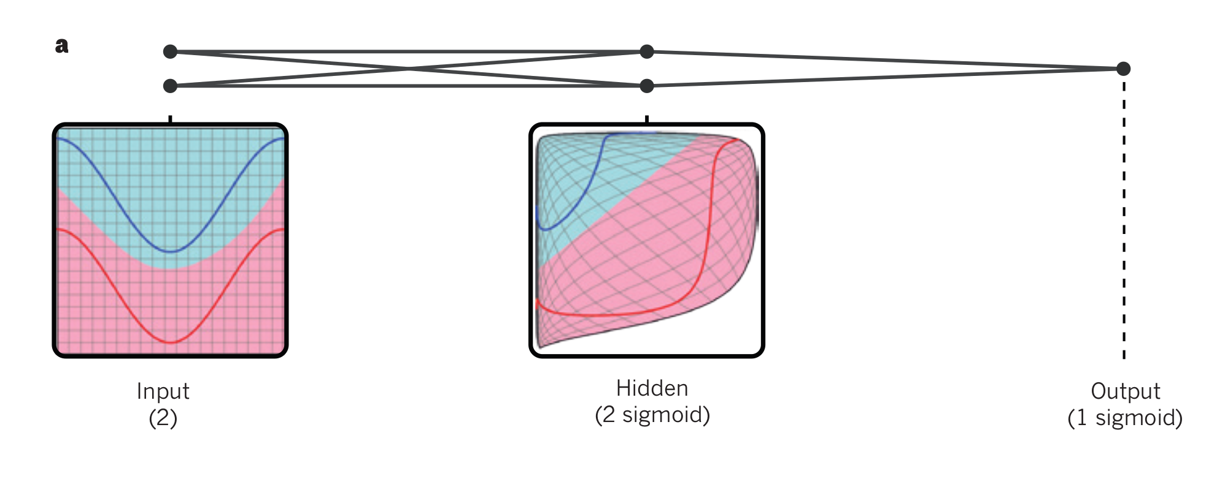
The representation view. Warping space
A neural network with two inputs, two hidden units and one output “warps”
space so that data can become linearly separable.

Slide 49
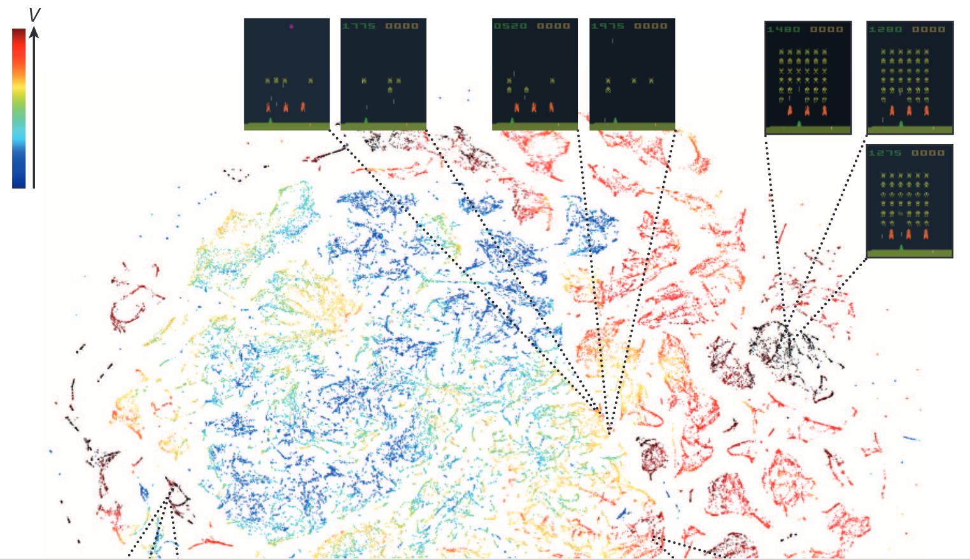

Slide 50
Functional view
Representation view
Usually well defined (eg. “linear regions”)
Useful for the theory of neural networks
Better at explaining the preference for deep neural networks
Not well defined (in general)
Many methods in the literature describe themselves as “learning representations”
Drove the research in transfer and self-supervised learning for some time
Shows up in natural language processing also, see “thought vectors”
Neural network depth associated with learning hierarchical representations

Slide 51
Deep Neural Networks

Slide 52
Reading suggestion
Check 4.1 and 4.2 in your textbook for a discussion on a special case of deep neural networks not covered in these slides.

Slide 53
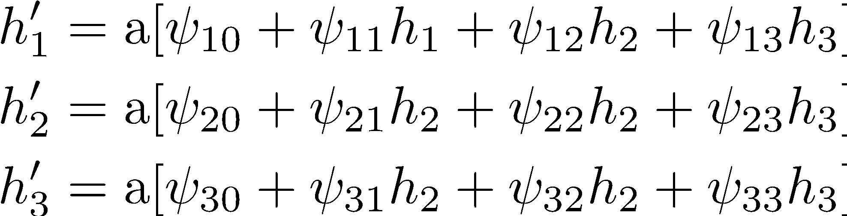
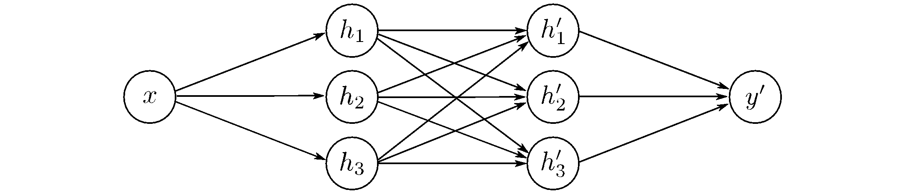
Two-layer networks

Slide 54
Remember shallow network with two outputs
1 input, 4 hidden units, 1 output

Slide 55
Deep networks are just function composition!
Consider the pre-activations at the second hidden units.
At this point, it’s a one-layer network with three outputs.

Slide 56
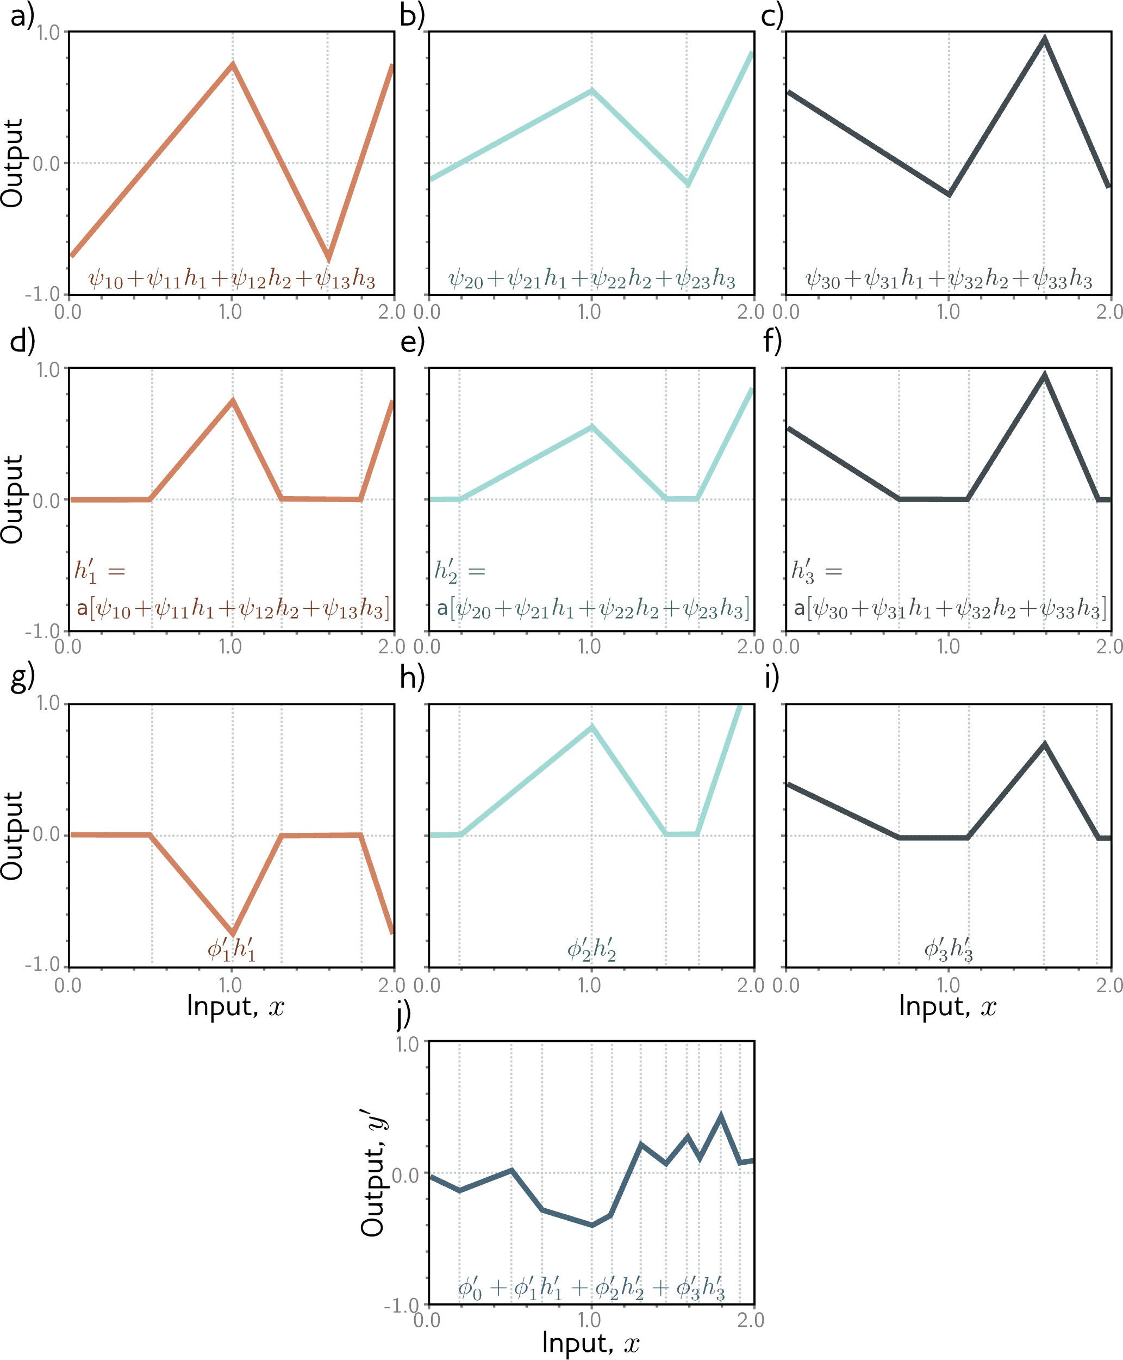

Slide 60
Hyperparameters
K layers: network depth
D_{k} hidden units / layer: network width
We chose these hyperparameters before training.
And we usually search for the best values by retraining with different hyperparameters.

Slide 61
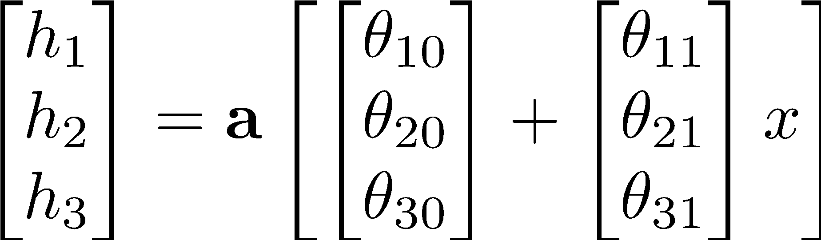
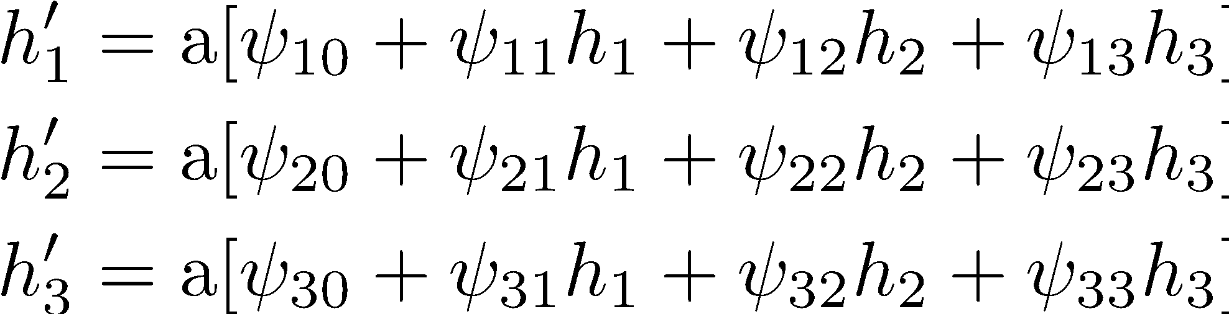
Notation change #1

Slide 62
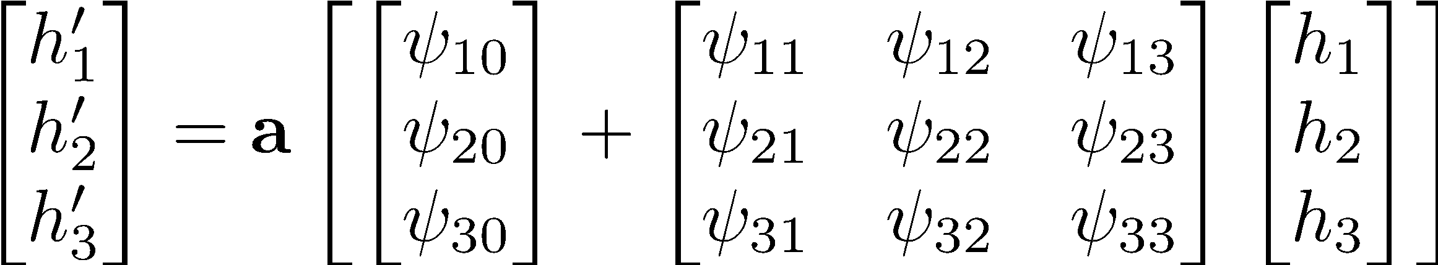
Notation change #1

Slide 63
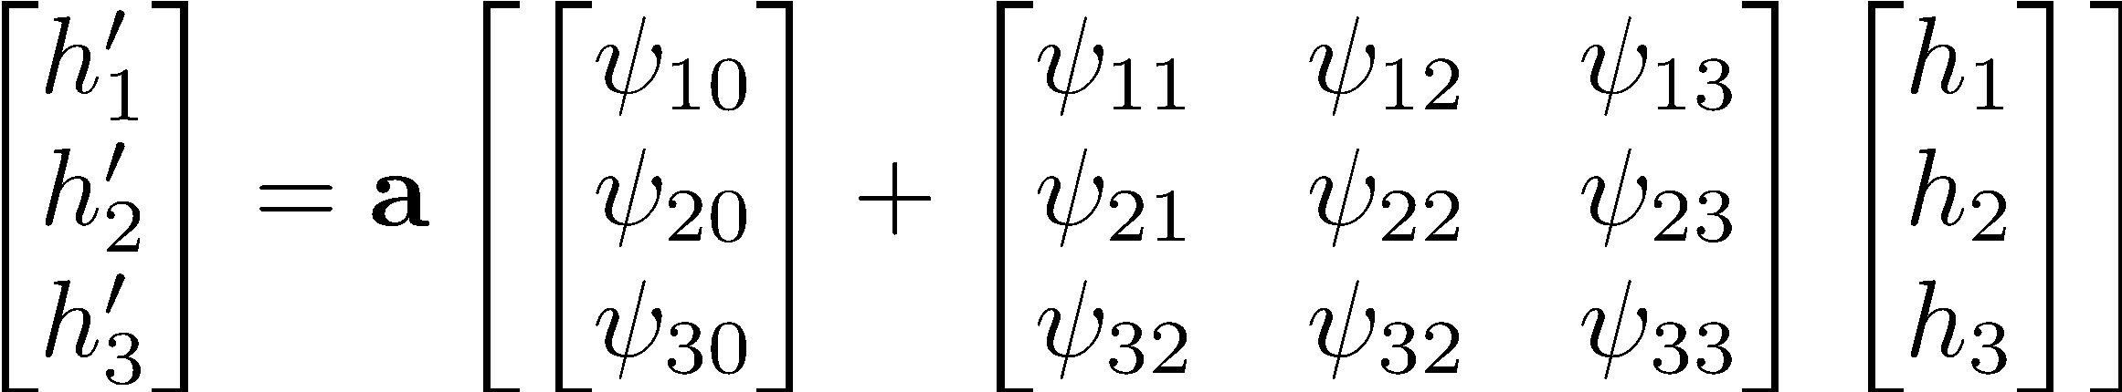
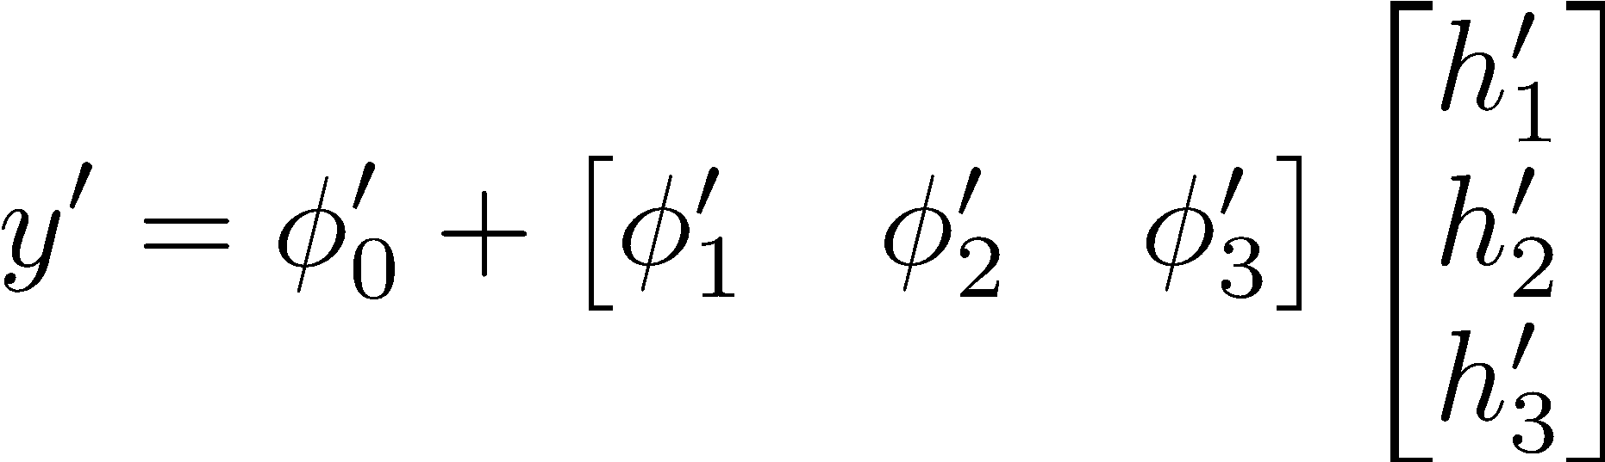
Notation change #1

Slide 64
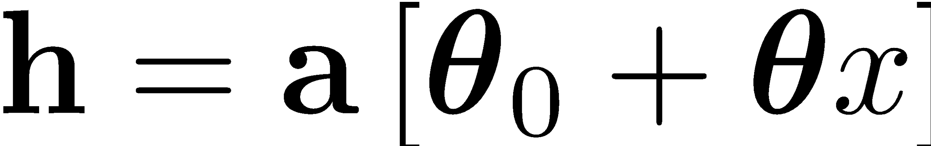
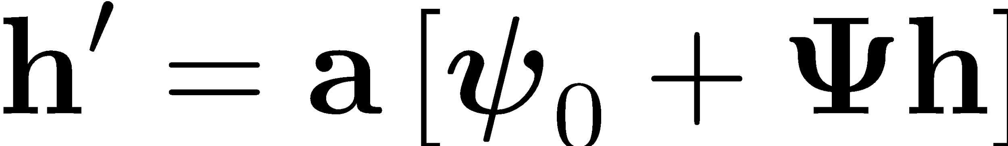

Notation change #2

Slide 65



Notation change #3 (multivariate inputs)

Slide 66
Notation change #3
Bias vector
Weight matrix

Slide 67

General equation for deep networks

Slide 68

…also known as an MLP (multi-layer perceptron)

Slide 69
Activation functions

Slide 70
Depth efficiency of neural networks

Slide 71

Shallow vs. deep networks

Slide 72
Shallow vs. deep networks
The best results are obtained by deep networks with many layers:
50-1000 layers for most applications
Over ~10-15 layers additional tricks are required (normalisation, residual connections)
Best results in:
Computer vision
Natural language processing
Graph neural networks
Generative models
Reinforcement learning

Slide 73
1. Function approximation capacity
They both obey the universal approximation theorem.
Argument: one layer is enough!

Slide 74


2. Number of linear regions per parameter
5 layers (up to)
10 hidden units per layer
471 parameters
161,501 linear regions
5 layers (up to)
50 hidden units per layer
10,801 parameters
10¹³⁴ linear regions

Slide 75
What’s next?
We have defined families of very flexible networks that map multiple inputs to multiple outputs
Now we need to train them
How to choose loss functions
How to find minima of the loss function
How to do this in particular for deep networks
Then we need to test them

Slide 76
How to reach me:
florin.gogianu@gmail.com
Please send unstructured feedback, since this is a new version of the lecture!

